Slide 1
Practical data science with python: Assessment 3
By Thaddeus Lee

Slide 2
introduction
Project Background
Procedure
Data preparation
Data Exploration
Data Modelling
Conclusion of results
Model recommendations

Slide 3
Project Background
Issue:
Connect 5G’s growing network and customer base has been met with increase of spam texts across their network.
Given the premium Connect 5G charge for their services, customers believe Connect 5G is responsible for producing a solution and the company is at risk to losing customers to competing service providers.
Response:
Connect 5G has tried to resolve the issue by blacklisting specific mobile numbers.
However, spammers continuously create new numbers, making this approach unsuccessful.

Slide 4
Project background
Response:
Connect 5G aim to develop a service for its customer base, that will classify incoming messages as either ham(not spam) and spam messages based on their content.
Texts identified as spam are then moved to a separate folder for spam messaages without notifying the customer thereby improving the customer experience.
Our firm, Revolution Consulting has been tapped for its expertise in data science to apply a machine learning algorithm that we will train and test.

Slide 5
Objective / Questions
Objective:
From data collected by Connect 5G, develop a modelling solution that will detect incoming SMS texts and classify them as either spam or not spam (Ham)
Guiding questions:
Is the given dataset balanced or not? • How did you go about creating features from the data?
How did you go about conducting the evaluation?
How do both machine learning models compare in terms of their performance to the dataset

Slide 6
Procedure
Data Preparation: - Feature creation
To prepare our data for modelling, we need to turn our SMS messages (textual data) into numerical features. We achieve this through Count Vectorizer, an algorithm that tokenises a text document by words and counts how many times each word appears to create a feature vector.
Conversion to lower-case:
All letters of each word are converted to lower-case
Data Preparation – Tokenisation:
For each data set (ham and spam), we breakdown the sentences and phrases in the text messages into smaller components – words – through tokenisation.
Data Preparation – Stop Words
Removes uninformative words from the text.
E.g. 'i', 'me', 'my', 'myself', 'we', 'our', 'ours', 'ourselves', 'you', "you're"

Slide 7
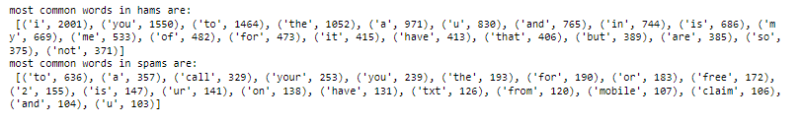
Procedure
Data Exploration:
Is our data set balanced?
len(sms_spam_prep)/len(sms_spam_prep+sms_ham_prep)
Spam messages account for 13.1564% - so imbalanced data set.
Ham = 4647
Spam = 704
Most common words in spam and ham:
https://stackoverflow.com/questions/29903025/count-most-frequent-100-words-from-sentences-in-dataframe-pandas

Slide 8
Data Modelling
K Nearest Neighbours (KNN)
Decision Trees
KNN is used for both classification and regression problems.
Based on feature similarity approach.
Takes two points and returns distance between those points.
Assumes that two points with a smaller distance between them are more similar than two points with a larger distance between them.
This process will return an unordered array, where each entry in the array holds the distance between p and one of the n data points in the model's database. So, the returned array will be of size n.
K is an arbitrary value between 3-11, that tells the model how many most similar points to p it should consider when classifying p.
Supervised learning algorithm used for classification and regression techniques.
Decision Trees breaks the samples or population into two or more equivalent groups which depends on the most significant splitter( or differentiator) in input variables.
A decision tree is presented as a structure of a flowchart. It demonstrates one approach of how we make decisions whose logic is similar to "if-this-then-that". In a decision tree
In a decision tree,
each non-leaf/internal node represents a "test" on an attribute or feature, questions asked are binary questions which can have answers like True/False, Yes/No,
each branch represents the outcome of the test, and
each leaf node represents a class label (decision taken after computing all attributes).

Slide 9
Data Modelling
KNN Parameters
Decision Trees Parameters
n_neighbours: n_neighbors: int, optional (default = 5) This is the number of neighbours to use. The optimal choice of value is highly data-dependent. Generally, a larger value suppresses the effects of noise but makes the classification boundaries less distinct.
Weights: can be ‘uniform’ – All points in each neighbourhood are equal. ‘Distance’ – where closer neighbours of a query point will have greater influence than those further away.
Metric: string or DistanceMetric object (default = ‘minkowski’) The distance metric. The default metric is Minkowski, and with p=2 is equivalent to the standard Euclidean metric.
P: integer, optional (default = 2) Power parameter for the Minkowski metric. When p = 1, this is equivalent to using manhattan_distance (l1), and euclidean_distance (l2) for p = 2.
Min samples – node split: Defines minimum samples or observations required in a node to be considered for splitting.
Min samples – leaf split: Defines the minimum samples required in a leaf
Max depth: Controls overfitting. A higher depth will allow model to learn relations very specifid to a particular sample.
Max number – Terminal nodes: Sets the maximum number of terminal nodes in a decision tree. Can be used in place of max depth.
Max features: Number of features to consider while searching for best split.
Gini index: Provides a measurement for the scale of possibility of a specific variable being mistakenly organised into groups when it is randomly selected. The closer the index is to 1, the higher the homogeneity.

Slide 10
Data Modelling
Process:
Create a Train Test Split (80% Train, 20% Test)
Use Grid Search, a hyperparameter tuning technique that searches for optimum hyperparameters through a predefined subset of a learning algorithm's hyperparameter space. Improving accuracy.
KNN – n_neighbors, p
Decision Trees – min_samples_split, min_samples_leaf and max_depth
Use Synthetic Minority Oversampling Technique (SMOTE). An oversampling technique which generates synthetic samples of a minority class (in our case, Spam) to create a balanced data set. This improves accuracy for predicting the minority class (spams).
Run test data set through KNN and Decision Trees models each with imbalanced and balanced data.

Slide 11
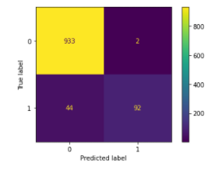
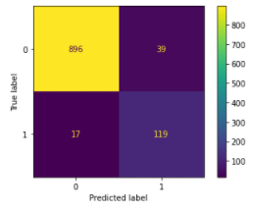
Results/ Conclusions
KNN
P = 2
n_neighbors = 1
True Negative = 933
False Positive = 44
True Negative = 92
False Negative = 2
KNN (SMOTE)
P = 2
n_neighbors = 1
True Negative = 896
False Positive = 17
True Negative = 119
False Negative = 39

Slide 12
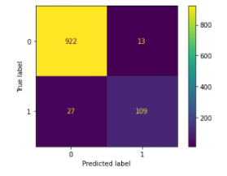
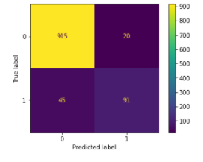
Results/ Conclusions
Decision Tree (SMOTE)
Max Depth = 20
Min Leaf = 5
Criterion = Gini
True Negative = 915
False Positive = 45
True Negative = 91
False Negative = 20
Decision Tree
Max Depth = 20
Min samples leaf = 5
Criterion = Gini
True Negative = 922
False Positive = 27
True Negative = 109
False Negative = 13

Slide 13
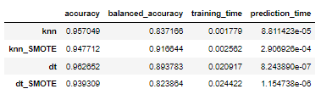
Conclusions/ Recommendations
Important evaluation of models produced for this project are prediction time – as people can receive a lot of texts and they need to be classified quickly!
Decision Trees has fastest prediction time per text, followed by DT(SMOTE), KNN and KNN(SMOTE)
DT is quicker for prediction as it builds model using training set, whereas KNN does not, instead KNN compares new observations with instances it sees in training. This means that at prediction time, KNN takes longer and is computationally more expensive than DT.
Scenarios where limited computational resources and efficient prediction times are a factor, can make DT the preferable model.
Due to data set being imbalanced, ‘balanced accuracy’ is best measure for evaluating models on accuracy:
((correctly predicted spams/spams in test set) + (correctly predicted hams/hams in test set))/number of classes = balanced accuracy
KNN SMOTE is most accurate 91.66%, followed by DT 89.38%, then DT(SMOTE)82.39%, and KNN 83.72%.
Given that Connect 5G Connect intends for this solution to be in the form of an app that is downloaded and handles the sms classifying locally on the handset, resources available for computing and battery are a factor, they might want to consider DT which provides fastest prediction time. It can significantly reduce incoming spam messages from coming through, even if it comes at expense balanced accuracy when compared to KNN(SMOTE).

Slide 14
References
Stack Overflow
Chamodya, Y 2020, How to use word tokenize in data frame
<https://stackoverflow.com/questions/33098040/how-to-use-word-tokenize-in-data-frame reference/>
Stack Overflow
Climbs_lika_spyder 2020, Python remove stop words from pandas dataframe
<https://stackoverflow.com/questions/29523254/python-remove-stop-words-from-pandas-dataframe/>
Quora
Routray, C 2018, How can I do machine learning usingikit-learn for a CSV file that has many text columns
<https://www.quora.com/How-can-I-do-machine-learning-using-scikit-learn-for-a-CSV-file-that-has-many-text-columns/>
Stack Overflow
Beasley, J 2015, Count most frequent 100 words from sentences in Dataframe Pandas
<https://stackoverflow.com/questions/29903025/count-most-frequent-100-words-from-sentences-in-dataframe-pandas>

